Slide 1
California Retailers Association
Increased Interaction Between Workplace Safety and Health Laws and Labor
September 17, 2024
Rachel L. Conn
Chair, California Practice
Conn Maciel Carey LLP’s Cal/OSHA Practice

Slide 2
Rachel L. Conn rconn@connmaciel.com • 415-866-4849
Rachel L. Conn is a Partner and Chair of Conn Maciel Carey’s California Practice. She is based out of the firm’s San Francisco office.
Focuses on OSH compliance and litigation, including inspections, audits, investigations, and enforcement actions involving Cal/OSHA, fed OSHA, and other State OSH Plans.
Represents employers and trade associations in Cal/OSHA and fed OSHA rulemakings.
Previously, Rachel was a partner and led the national OSHA Practice at an AmLaw 100 law firm.

Slide 3
Agenda
Workplace Restraining Orders
Indoor Heat Prevention Regulation
SB 553
Draft Cal/OSHA Workplace Violence Regulation
Fed/OSHA Worker Walkaround Rule

Slide 4
California’s New General Industry Workplace Violence Law (SB 553)

Slide 5
SB 553 – Workplace Violence Prevention

Slide 6
SB 553- Authorized Employee Representatives
Not defined by the statute, but typically defined by Cal/OSHA as:
“An authorized employee representative is an authorized collective bargaining agent of employees.” 8 CCR § 14300.35
Authorized Employee Representatives Rights under SB 553:
Access to Plan at all times
Active involvement in developing & implementing the Plan
Including but not limited to: participation in identifying, evaluating, and correcting workplace violence hazards, in designing and implementing training, and in reporting and investigating workplace violence incidents

Slide 7
SB 553- Authorized Employee Representatives
Active involvement of employees and authorized employee representatives in reviewing the plan
Access to records:
Training, inspections, & violent incident logs

Slide 8
Practical Implementation Advice: Employee and Authorized Employee Representative Involvement
How can employees provide feedback on the WVPP?
To whom?
Hotline?
Anonymous reporting?
Safety committees?
Morning huddles?
Safety meetings?
How will the company encourage participation in inspections and development of training material and the plan?

Slide 9
Workplace Violence Restraining Order CA Code of Civil Procedure 527.8
Under Calif. law, courts can make orders to protect an employee from suffering unlawful violence or credible threats of violence at the workplace
The court can order a person to:
Not harass or threaten the employee
Not contact or go near the employee
Not have a gun
Employees cannot ask for Workplace Violence Protective Orders (only Employers)
Order can also protect certain family or household members of the employee
Can also protect other employees at the same workplace or others of the employer
Orders are enforced by law enforcement agencies

Slide 10
Workplace Violence Restraining Order
Employee has suffered unlawful violence (e.g., assault, battery, or stalking) or a credible threat of violence
Unlawful violence or threat of violence can reasonably be construed to be or have been carried out at the workplace
Conduct of accused is not otherwise allowable as part of a legitimate labor dispute or constitutionally protected activity
“Credible threat of violence” =
Intentionally saying something or acting in a way that would make a reasonable person afraid for his or her safety or the safety of his or her family
which Includes
following / stalking or making harassing calls / sending harassing messages by phone, mail, or e-mail over a period of time (even a short time)

Slide 11
SB 553 – Workplace Violence Restraining Orders
Would require Employer or collective bargaining representative to provide the employee an opportunity to decline to be named before filing
Would NOT prohibit Employer or collective bargaining representative from seeking a Temporary Restraining Order on behalf of other employees at the workplace
Beginning 1/1/25 – Authorizes employees’ collective bargaining representatives to seek a WPV Restraining Order on behalf of an employee and other employees at the same workplace

Slide 12
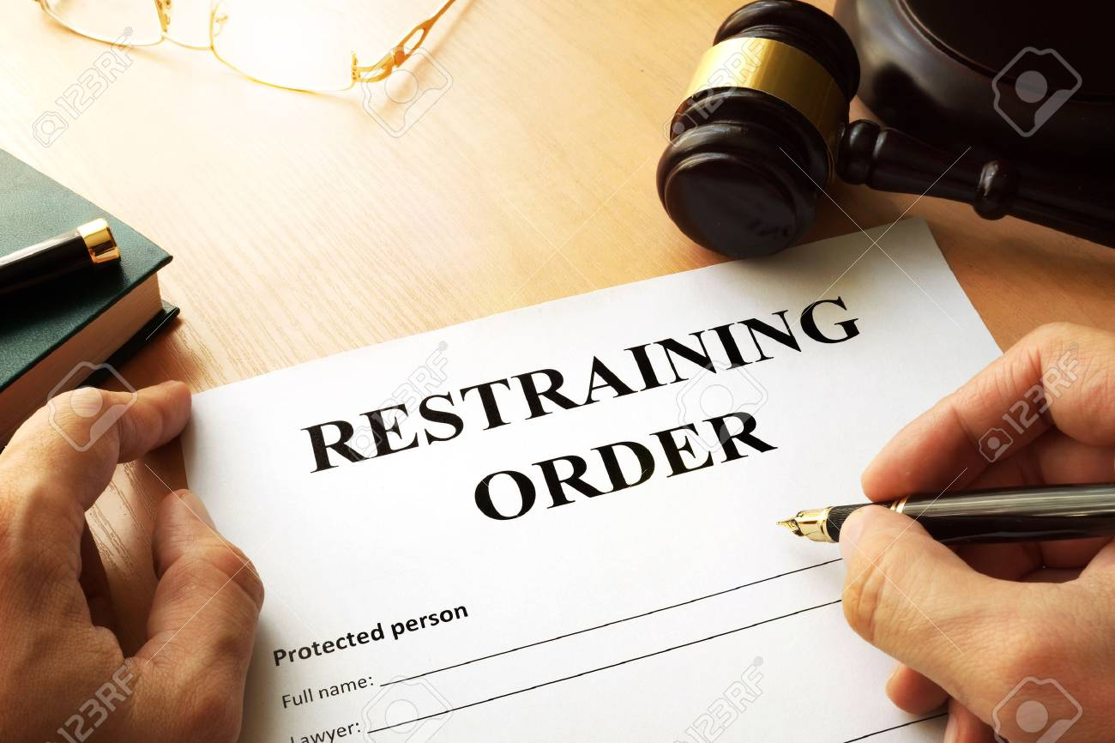
SB 428 - TROs: Employee Harassment​
Current law enables Employers to seek a Temporary Restraining Order to protect employees from a person who has engaged in or made a credible threat of violence
Effective January 1, 2025, Employers may seek a Temporary Restraining Order against an individual who has harassed an employee and their immediate family members​

Slide 13
Cal/OSHA Regulation
Specifically calls for the Division to propose no later than Dec. 31, 2025, and the Standards Board to adopt no later than Dec. 31, 2026, standards regarding the required plan
Standard must include, at a minimum, requirements outlined in Sec. 6401.9 and “any additional requirements the Division deems necessary and appropriate to protect employees’ health and safety”
Draft released on July 15, 2024
Additional Advisory Committee meeting is expected

Slide 14
Draft Workplace Violence Prevention Standard
Authorized Employee Representative Additions:
Employers must communicate with “authorized employee representatives,” as well as employees, regarding:
How to report incidents;
How incidents will be investigated; and
Results of workplace violence investigations.
Notes:
For purposes of reducing workplace violence hazards, engineering controls include, but are not limited to: electronic or mechanical access controls to employee occupied areas; weapon detectors (installed or handheld); enclosed workstations with shatter-resistant glass; deep service counters; spaces configured to optimize employee access to exits, escape routes, and alarms; separate rooms or areas for high risk persons; locks on doors; furniture affixed to the floor; opaque glass (protects privacy, but allows employees to see where potential risks are); improving lighting in dark areas, sight-aids, improving visibility, and removing sight barriers; video monitoring and recording; and personal and workplace alarms.
Work practice controls include, but are not limited to: appropriate staffing levels; provision of dedicated security personnel; an effective means to alert employees of the presence, location, and nature of a security threat; control of visitor entry; methods and procedures to prevent unauthorized firearms and weapons in the workplace; employee training on workplace violence prevention methods; and employee training on procedures to follow in the event of a workplace violence incident or emergency.
Workplace violence hazards shall include, but are not limited to: 1. Employees working alone or in locations isolated from other employees; 2. Areas with poor illumination or blocked visibility (e.g. blind spots) of surrounding areas; 3. Entries to places of employment where unauthorized access can occur; 4. Work locations, areas, or operations that lack effective escape routes; 5. Presence of money or valuable goods; 6. Frequent or regular contact with the public; 7. Working late at night or early morning; 8. Selling, distributing, or providing alcohol, marijuana, or pharmaceutical drugs

Slide 15
Draft Workplace Violence Prevention Standard
Additions in draft include specific procedures for post-incident response and investigation, including:
Soliciting from employees involved in the incident:
Their opinions regarding the cause of the incident
Whether any measure would have prevented the incident

Slide 16
Indoor Illness Prevention

Slide 17
Cal/OSHA Indoor Heat Illness Prevention
The employer shall have effective procedures to obtain the active involvement of employees and their union representatives in the following:
1. Planning, conducting, and recording the measurements of temperature or heat index, whichever is greater.
2. Identifying and evaluating all other environmental risk factors for heat illness.

Slide 18
Worker Walkaround Representative Designation Process Rule

Slide 19
Original Worker Walkaround Representative Rule
Old Reg Text of 1903.8(c):
“Representatives authorized by employees shall be employees of the employer. However, if in the judgment of the CSHO, good cause has been shown why accompaniment by a 3rd party who is not an employee of the employer (such as a CIH or professional safety engineer) is reasonably necessary to the conduct of an effective and thorough physical inspection of the workplace, such 3rd party may accompany the CSHO during the inspection.”

Slide 20
2013 Interpretation of Union Inspection Rights
2/21/13 – OSHA issued an Interpretation Letter in response to a request from a Union:
Q: May workers at a worksite w/out a collective bargaining agreement designate a person affiliated w/ a union or a community organization to act on their behalf as a walkaround representative?
Notwithstanding a clear bias against 3rd party participation in OSHA inspections in OSHA’s regulation at 1903.8(c), OSHA responded to the union in the affirmative:
A: “Although the reg acknowledges that most employee reps will be employees of the employer being inspected … it is OSHA’s view that [non-employee] reps are reasonably necessary’ when they will make a positive contribution to a thorough and effective inspection.”
Industry challenged the Interpretation Letter, asserting it was so inconsistent w/ 1903.8(c) that it effectively rewrites the reg w/out APA notice-and-comment rulemaking
April 2017 –OSHA rescinded the 2013 Interpretation Letter

Slide 21
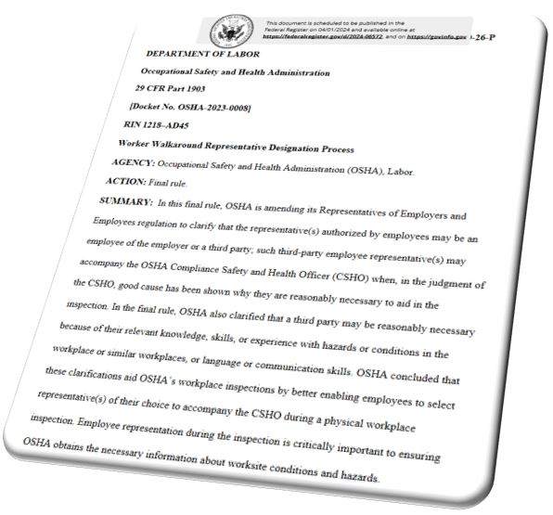
Worker Walkaround Representative Rulemaking
Jan. 2023 - OSHA initiated a “Worker Walkaround Representative Designation Process” rulemaking to amend 1903.8(c) – memorialize the 2013 interpretation
“This rulemaking will clarify the right of workers … to specify a worker or union representative to accompany an OSHA inspector during the inspection/walkaround, regardless of whether the rep is an employee of the employer….”
8/30/23 - OSHA issued a NPRM
4/3/24 - Final Rule Published in the Fed Register
May 31, 2024 – Effective Date of new Final Rule
State Plans have 6 months to adopt the Rule (or one that is at least as effective)

Slide 22
Final Worker Walkaround Representative Rule
Eliminate extreme bias against 3rd party involvement in OSHA inspections (shall be employees of the employer → may be an employee of the employer or a 3rd party)
Increase types of 3rd parties permitted in OSHA inspections (CIH or safety engineer → anyone w/ relevant knowledge, skills, or experience w/ hazards in similar workplaces)
Proposed expanding role 3rd parties can play in OSHA inspections (from “accompanying” OSHA for the physical walkaround to “participation” in the inspection) [not included in final rule]
Final New Reg Text of 1903.8(c):
Representative(s) authorized by employees may be an employee of the employer or a 3rd party. When the representative(s) authorized by employees is not an employee of the employer, they may accompany the CSHO during the inspection if, in the judgment of the CSHO, good cause has been shown why accompaniment by a 3rd party is reasonably necessary to the conduct of an effective and thorough physical inspection of the workplace (including but not limited to b/c of their relevant knowledge, skills, or experience w/ hazards or conditions in the workplace or similar workplaces, or language or communication skills).

Slide 23
Final Worker Walkaround Representative Rule
Old Reg Text of 1903.8(c):
“Representatives authorized by employees shall be employees of the employer. However, if in the judgment of the CSHO, good cause has been shown why accompaniment by a 3rd party who is not an employee of the employer (such as an IH or safety engineer) is reasonably necessary to the conduct of an effective and thorough physical inspection of the workplace, such 3rd party may accompany the CSHO during the inspection.”
Proposed Reg Text of 1903.8(c):
Representative(s) authorized by employees may be an employee of the employer or a 3rd party. When the representative(s) authorized by employees is not an employee of the employer, they may accompany the CSHO in the inspection if, in the judgment of the CSHO, good cause has been shown why their participation is reasonably necessary to the conduct of an effective and thorough physical inspection of the workplace (e.g., b/c of their relevant knowledge, skills, or experience w/ hazards or conditions in the workplace or similar workplaces, or language skills).
Final New Reg Text of 1903.8(c):
Representative(s) authorized by employees may be an employee of the employer or a 3rd party. When the representative(s) authorized by employees is not an employee of the employer, they may accompany the CSHO during the inspection if, in the judgment of the CSHO, good cause has been shown why accompaniment by a third party is reasonably necessary to the conduct of an effective and thorough physical inspection of the workplace (including but not limited to b/c of their relevant knowledge, skills, or experience w/ hazards or conditions in the workplace or similar workplaces, or language or communication skills).

Slide 24
Who May Get To “Walkaround” Your Facility?
Union Representatives at non-union workplaces accessing workplaces and employees for organizing, influencing bargaining, etc.
Plaintiffs’ Attorneys (or their “experts”) piggyback on OSHA’s broad investigative/subpoena authority (access site, records and evidence, and participate in private employee interviews)
Disgruntled Former employees
Worker advocacy and other activist organizations (PETA, environmental activists, etc.)
Attorneys and consultants “experienced in interacting w/ gov’t officials,” or “w/ relevant cultural competencies”
Technical experts with more expertise than OSHA has in-house
Competitors accessing proprietary information
Customers
Media

Slide 25
Fed/OSHA FAQs
How many employees are required to authorize a walkaround representative? A majority of the workforce or the department at issue in the inspection, for example? Can a single employee authorize the representative?
No set number of employees are required to authorize an employee walkaround representative. It is not necessary for all, or even a majority, of employees to authorize the walkaround representative. However, in a workplace with more than one employee, more than one employee would be needed to authorize the walkaround representative.
https://www.osha.gov/worker-walkaround/final-rule/faq

Slide 26
Fed/OSHA FAQs
How many walkaround representatives can there be on an inspection?
1 employee and 1 employer representative shall accompany the CSHO on the inspection, but the CSHO may permit additional employer representatives and additional authorized employee representatives if the additional representatives will further aid the inspection.
A different employer and employee representative may accompany the CSHO during each different phase of an inspection if this will not interfere with the conduct of the inspection.

Slide 27
Fed/OSHA FAQs
In a unionized workplace, can employees designate a representative who is not affiliated with their union?
If the CSHO determines that an additional walkaround representative would further aid the inspection, the CSHO may permit an additional representative authorized by employees on the walkaround inspection, even if that individual is not affiliated with the union.

Slide 28
What are the Risks?
Access to employees for union organizing and influencing bargaining
Increase in complaint filings and work stoppages
Potential influencing of witnesses
Early access to the site, records and evidence, and witnesses (piggybacking on OSHA’s broad investigative/subpoena authority)
Threat of violence from disgruntled employees
Sabotage and/or theft of trade secrets and proprietary information
Information used to promote legislative and political agendas
Information used to publicly criticize/shame the employer

Slide 29
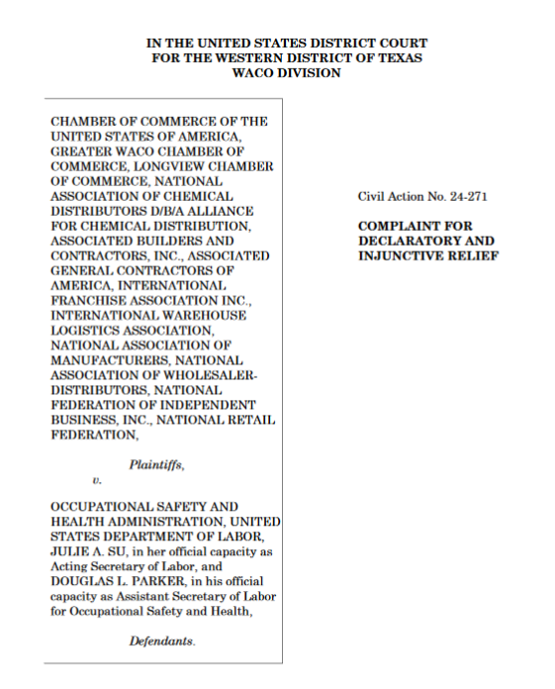
Legal Challenge to Worker Walkaround Rule
5/21/24 – U.S. Chamber of Commerce and several trade associations sued OSHA challenging the legality of the Worker Walkaround Rule
The action was filed in the U.S. District Court for the Western District of Texas
In Chamber of Commerce v. OSHA, the challenging plaintiffs seek declaratory and injunctive relief
Notes:
The business groups standing alongside the Chamber in Tuesday's lawsuit include the National Retail Federation, the National Association of Manufacturers, the National Federation of Independent Business and Associated Builders and Contractors.
OSH Act provides limited right: “a representative of the employer and a representative authorized by his employees shall be given an opportunity to accompany the Secretary”

Slide 30
Cal/OSHA & Worker Walkaround Rule
California Labor Code 6314(d)
In the course of any investigation or inspection of an employer or place of employment by an authorized representative of the division, a representative of the employer and a representative authorized by his or her employees shall have an opportunity to accompany him or her on the tour of inspection. Any employee or employer, or their authorized representatives, shall have the right to discuss safety and health violations or safety and health problems with the inspector privately during the course of an investigation or inspection. Where there is no authorized employee representative, the chief or his or her authorized representatives shall consult with a reasonable number of employees concerning matters of health and safety of the place of employment.
Cal/OSHA intends to adopt Fed/OSHA regulation, but no timeline for adoption
01
Will not be submitted for a Horcher adoption (verbatim)
02
Potential advisory talks
03

Slide 31
Top Tips and Strategies for Employers
Designate and train an OSHA Inspection Team to manage inspections
Ensure team members know who to contact / what to do when OSHA arrives on site
Train the inspection team on each facet of an OSHA inspection, paying particular attention to the importance and objectives of the opening conference
Consider including OSHA-Specialist Counsel in OSHA Inspections
Decide in advance on your Warrant Strategy
Warrants, in most cases, are rarely the preferred strategic option, but now that OSHA can attempt to include unwelcome 3rd parties in site inspections, that changes the balance
Consider consent to OSHA’s inspection but refusing consent to 3rd party participation (OSHA will most likely treat that as an overall refusal to consent and will seek a warrant)
Move to quash or amend the warrant (proactive or after OSHA seeks to enforce the warrant)

Slide 32
Top Tips and Strategies for Employers
Develop “voir dire”/Daubert-type questions re: credentials/experience of 3rd party:
Will this representative offer relevant subject matter knowledge (i.e., knowledge of industry or consensus standards that are present in the workplace)?
What is this representative’s professional experience with the subject of the inspection? How is that experience unique and dissimilar from your (the CSHO’s) experience?
In what way is the representative’s experience/qualifications different from the CSHO’s?
Develop Confidentiality and/or Non-Disclosure Agreements for all non-patient invitees
Enforce PPE requirements for 3rd party representatives (no duty to provide them with PPE or sanitation tools), as well as cell phone/camera policies
Consider Workplace Violence Restraining Order against disgruntled former employees

Slide 33
Top Tips and Strategies for Employers
Designate Sensitive Areas w/in your workplace (e.g., trade secret areas) and exclude 3rd party inspection representatives from those areas
Establish a Safety Committee and/or a Specialized Work Groups (e.g., workplace violence, etc.) w/ non-supervisory employees and suggest that an employee representative from that group is a better option to assist the CSHO than an outsider
For multilingual workforces, ID employees able and willing to serve as interpreters, so OSHA does not suggest a union representative or some other 3rd party for that purpose
Promote channels for employees (anonymously or otherwise) to raise safety concerns to management, and take action in response
Notes:
1903.9(d) - Upon the request of an employer, any authorized representative of employees under §1903.8 in an area containing trade secrets shall be an employee in that area or an employee authorized by the employer to enter that area. Where there is no such representative or employee, the Compliance Safety and Health Officer shall consult with a reasonable number of employees who work in that area concerning matters of safety and health.

Slide 36
Scan the QR code below for event updates and to register.
Cal/OSHA and California Employment Law Summit:
The Latest Rulemaking, Legislative, and Enforcement Developments in the Golden State
Two Dates and Locations to Choose From
October 8th in Berkeley, CA | October 10th in Pasadena, CA
This program is currently under review for SHRM, HRCI, and California CLE credits.

Slide 37
Check Out Our Blogs

Slide 38
Training and Special Services
LEARN MORE
LEARN MORE
Advanced education opportunities to keep you current on key industry topics
Consulting services for complex issues
LEARN MORE
LEARN MORE

Slide 39
Questions?

Slide 40
Contact Information
Rachel L. Conn
California Practice Chair
OSHA • Workplace Safety Group
Conn Maciel Carey LLP
San Francisco, CA
415.866.4849
rconn@connmaciel.com

